Slide 1

By: Manas Tuwani

Slide 2
ENCAPSULATION
Encapsulation is defined as the wrapping up of data under a single unit. It is the mechanism that binds together code and the data it manipulates. Other way to think about encapsulation is, it is a protective shield that prevents the data from being accessed by the code outside this shield.
As in encapsulation, the data in a class is hidden from other classes, so it is also known as data-binding.
Encapsulation can be achieved by: Declaring all the variables in the class as private and writing public methods in the class to set and get the values of variables.

Slide 3
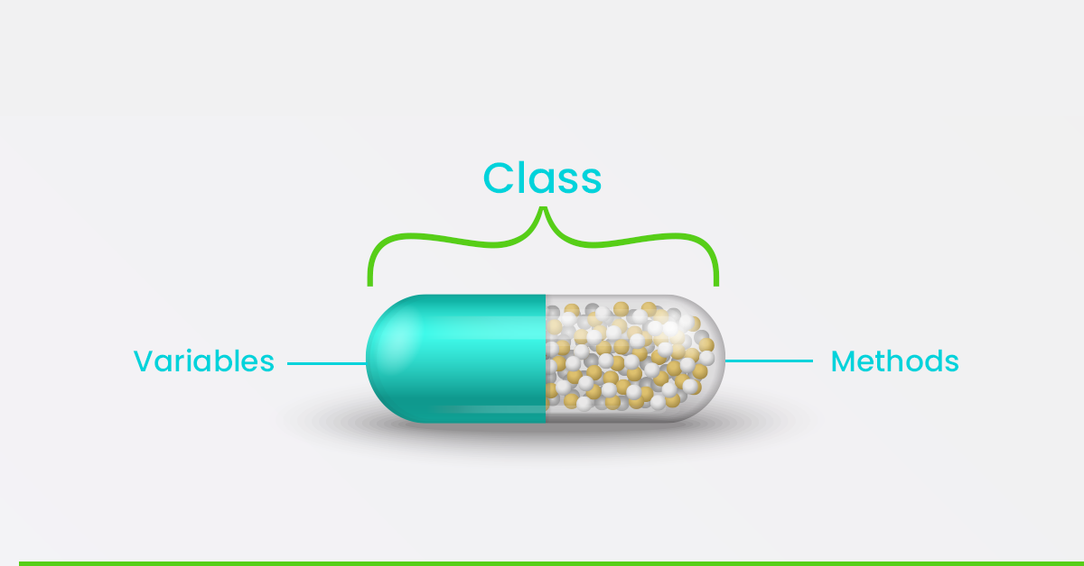
ENCAPSULATION
Encapsulation in Java is a process of wrapping code and data together into a single unit, for example, a capsule which is mixed of several medicines.
We can create a fully encapsulated class in Java by making all the data members of the class private. Now we can use setter and getter methods to set and get the data in it.

Slide 4
To achieve encapsulation in Java:
Declare the variables of a class as private.
Provide public setter and getter methods to modify and view the variables values.

Slide 5
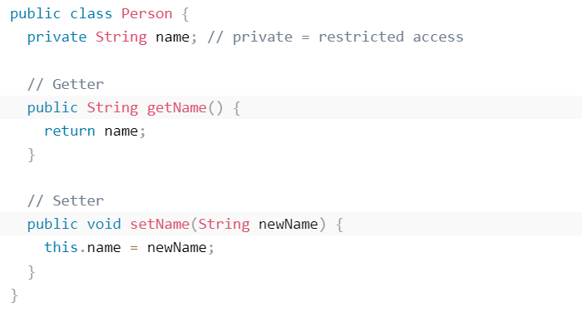
Get and Set Method
The get method returns the variable value, and the set method sets the value.
Syntax for both is that they start with either get or set, followed by the name of the variable, with the first letter in upper case:

Slide 6
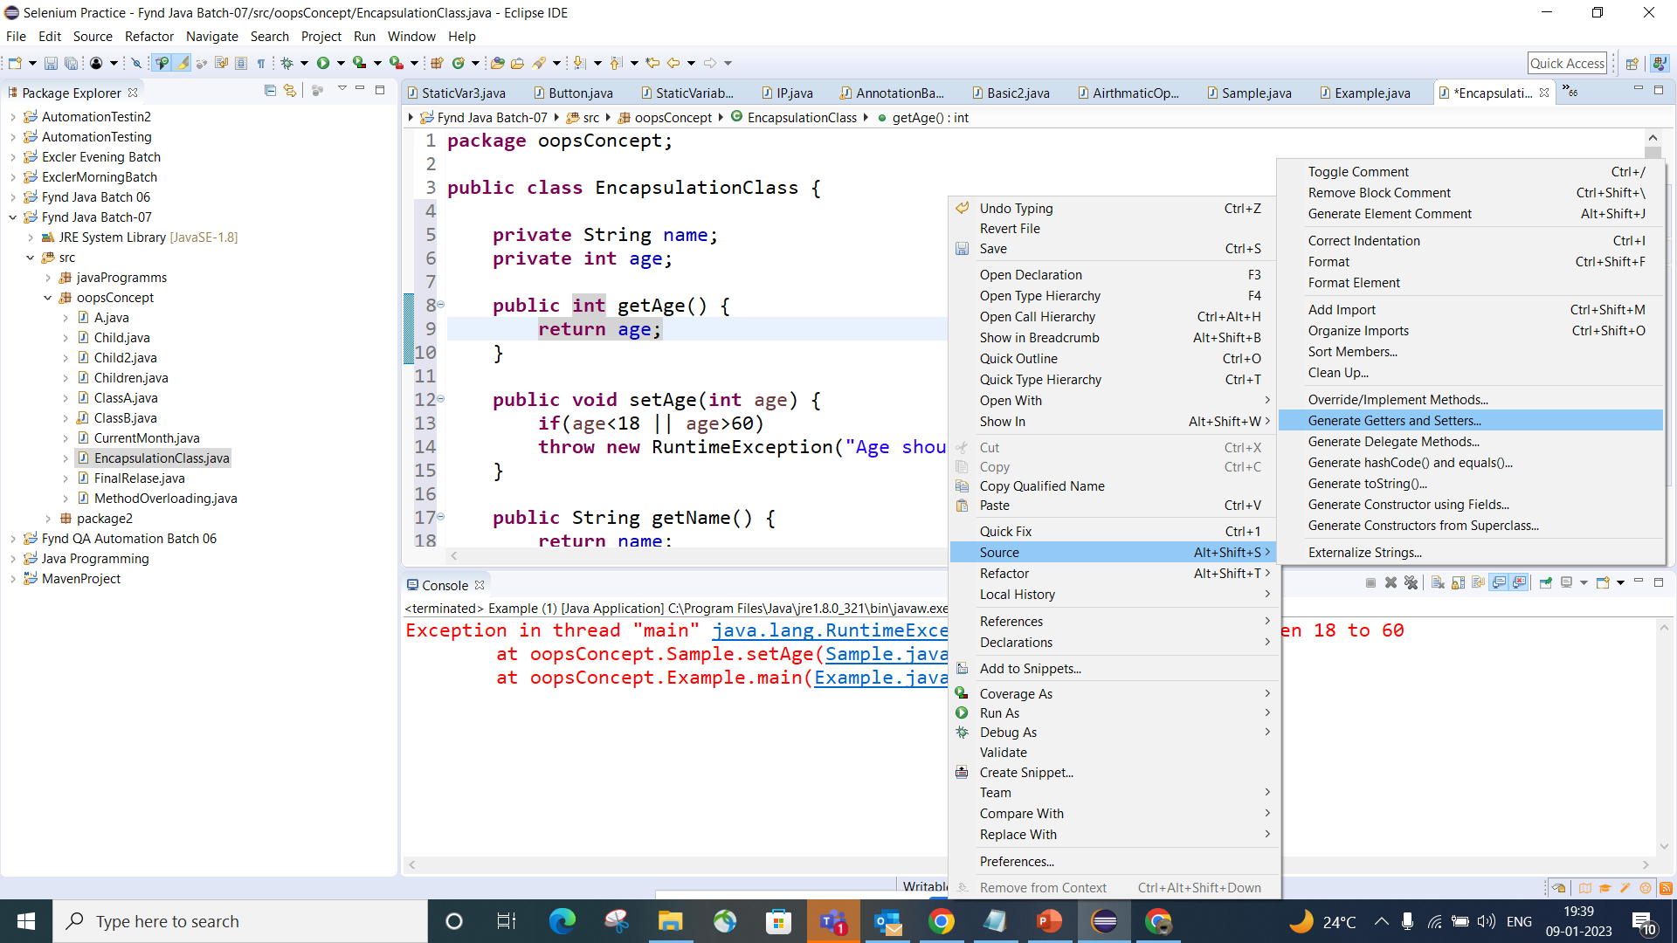

Slide 7
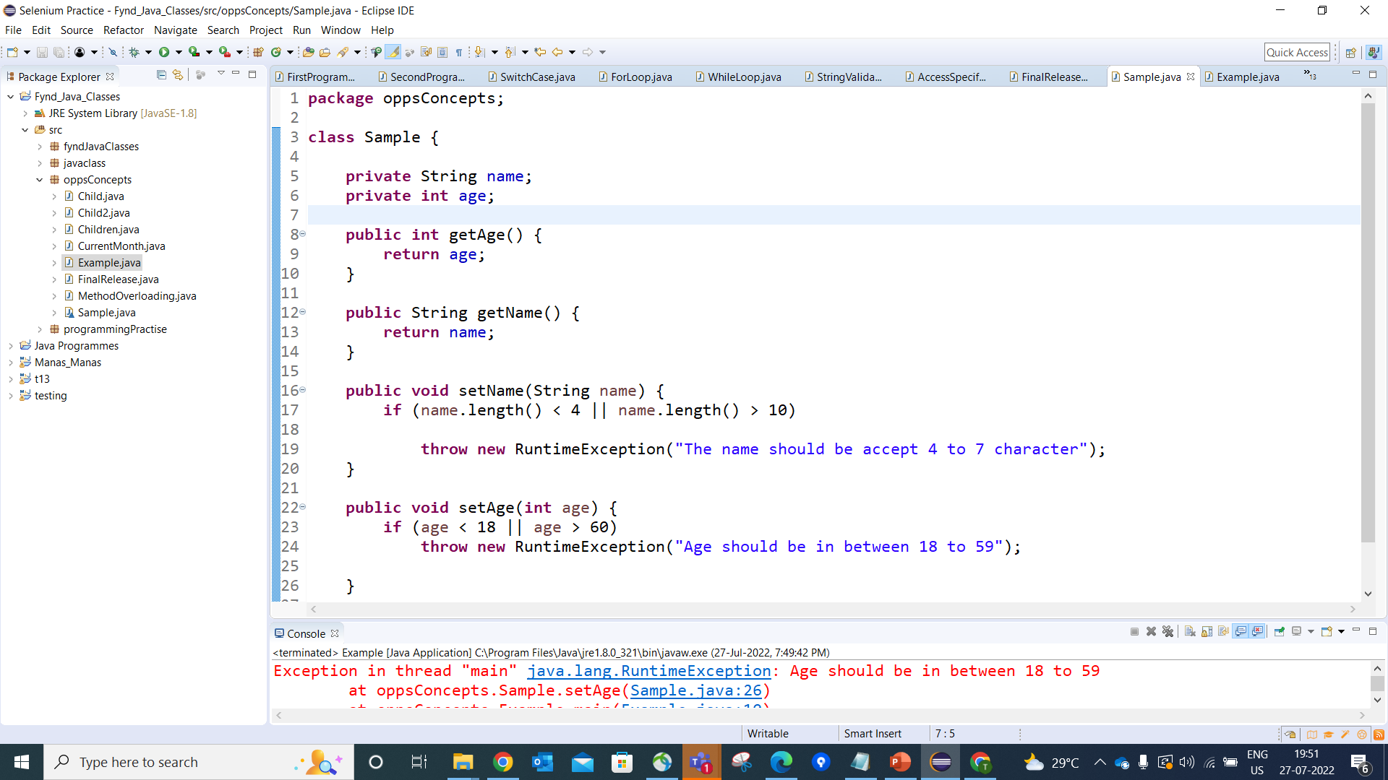

Slide 8
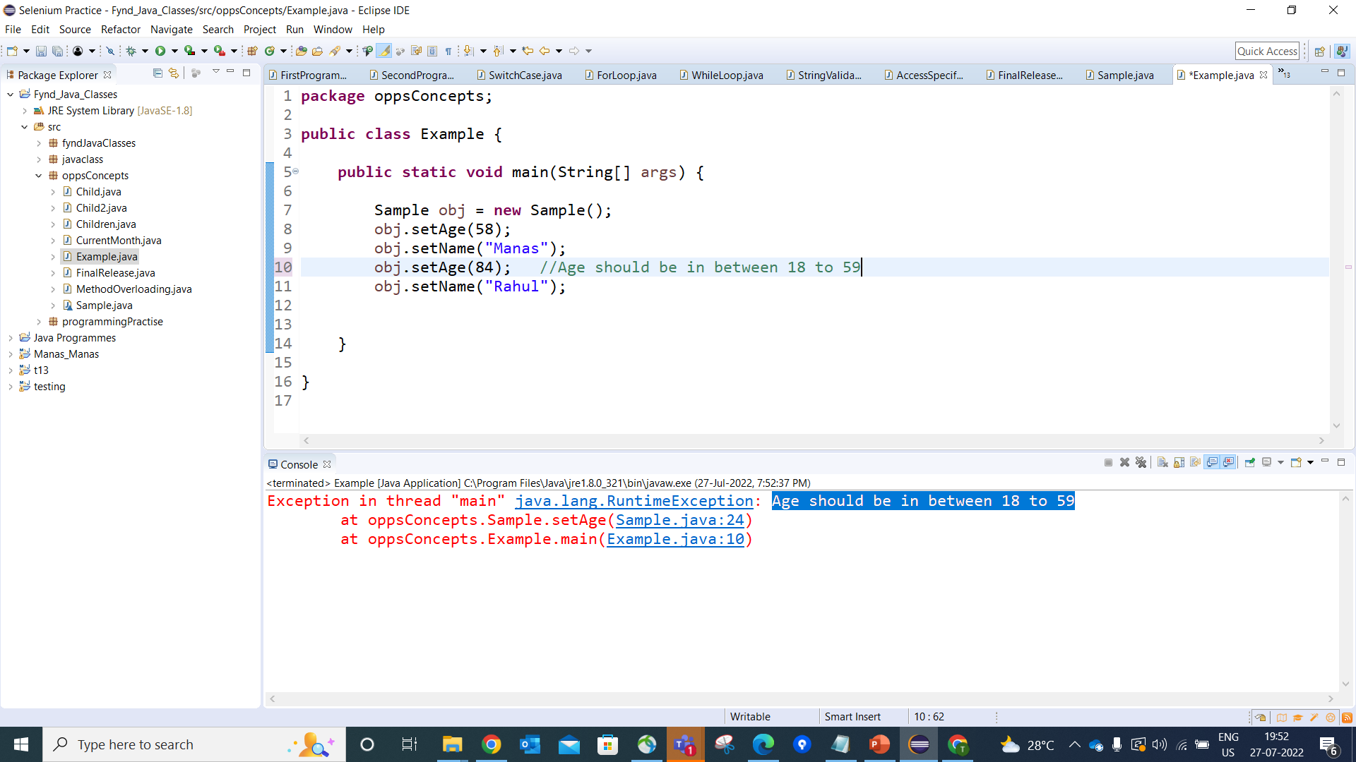
Note: The example shows that the internal variable age and name can only be changed via the setAge() and setName() method, which includes validation logic to ensure the data remains in a valid state. This is the power of encapsulation.

Slide 9
Advantage of Encapsulation in Java
It provides you the control over the data.
It is a way to achieve data binding in Java because other class will not be able to access the data through the private data members.
The encapsulate class is easy to test. So, it is better for unit testing.
By providing only a setter or getter method, you can make the class read-only or write-only.
Increased security of Data.

